Slide 1
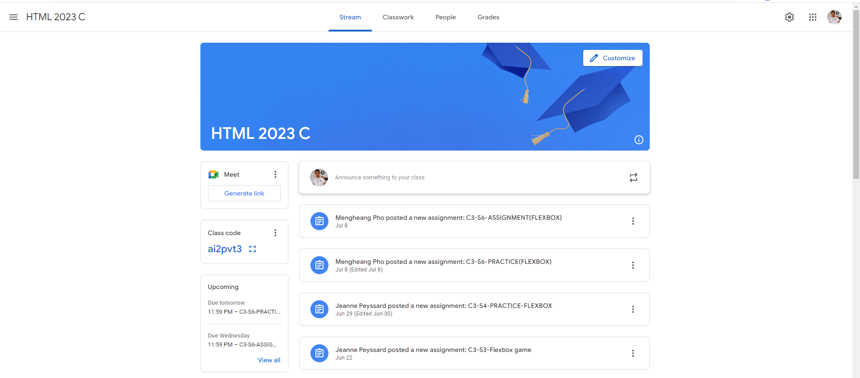
Identify root components of website below

Slide 2
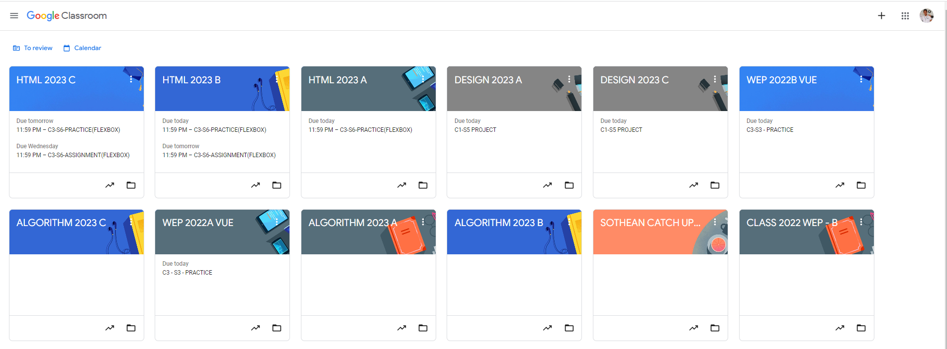
Root div
- Height: 100vh
content
nav
Flex: 0
header
Flex: 0
Flex: 1

Slide 3
Flex: 0 Navigator
Flex: 1
main

Slide 4
Flex: 1
navigator-left
Flex: 2
navigator-center
Flex: 1
navigator-right

Slide 5
Flex: 0
main-content
Flex: 1
main- sidebar
Flex: 3
main - infomation

